Slide 1

Customer Churn Prediction Model
Machine Learning Approach
Predictive analytics solution for identifying at-risk customers using CatBoost classifier

Slide 2
Customer Churn
Understanding Customer Attrition Types
Voluntary Churn
Customers intentionally leave due to dissatisfaction with service quality or pricing. They actively choose competitors offering better value propositions. This type represents conscious decisions driven by unmet expectations or superior alternatives in the market.
Involuntary Churn
Customers leave unintentionally due to technical or administrative issues beyond their control. Common causes include payment failures, expired credit cards, or system errors. This represents opportunities for proactive retention through improved processes.

Slide 3
Business Impact
Why Churn Prediction Matters
1. Cost-Efficient Retention Strategy
Retaining existing customers is 5-10 times more cost-effective than acquiring new ones, enabling targeted interventions for at-risk users.
2. Revenue Protection and Growth
Every lost customer represents lost future revenue. Predictive models help prioritize high-value users for maximum profitability.
3. Competitive Advantage and Scalability
Machine learning-based prediction offers real-time insights for millions of users, providing scalable intelligent retention strategies over competitors.

Slide 4
Project Objective
Primary Goal
Build a predictive machine learning model that identifies customers at risk of churning using historical data patterns.
Key Deliverables
The model performs binary classification to predict churn likelihood, assists businesses in making proactive retention decisions, and provides insights into contributing factors. This empowers business teams to implement personalized retention strategies, reduce revenue loss, and enhance long-term customer loyalty through data-driven decision making.

Slide 5
Dataset Overview and Key Features
The dataset contains 10,000 entries of customer records with 14 features related to demographics, banking activity, and churn status.
Feature | Type | Description | Values | Predictive | Importance
Age | Numeric | Customer age | 18-92 | High | Primary
Balance | Numeric | Account balance | 0-250k | Moderate | Secondary
Geography | Categorical | Country location | France/Spain/ Germany | High | Primary
IsActiveMember | Binary | Activity status | 0/1 | High | Primary
NumOfProducts | Numeric | Products held | 1-4 | Moderate | Secondary

Slide 6
Data Preprocessing Pipeline
Four-Step Transformation Process
1.
Data Cleaning
Removed irrelevant identification columns like RowNumber, CustomerId, and Surname
2.
Categorical Encoding
Applied label encoding for Gender and one-hot encoding for Geography
3.
Feature Scaling
Standardized numerical features using Standard Scaler for consistent scaling
4.
Data Splitting
Split dataset into 80% training and 20% testing sets

Slide 7
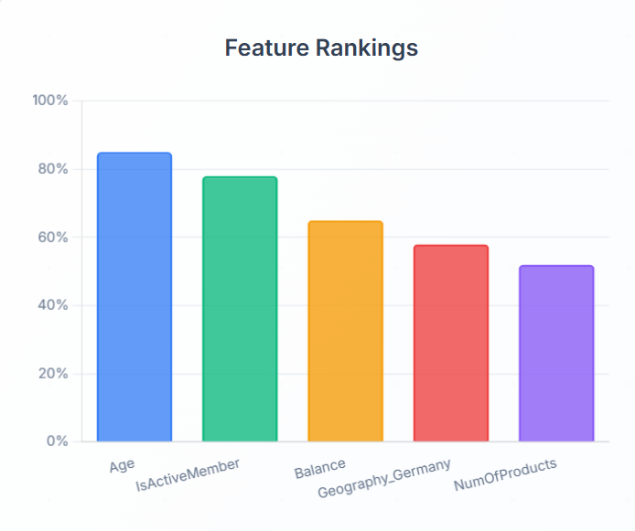
Feature Importance Analysis
Key Churn Predictors
Key Insights
Age emerged as the strongest predictor, with older customers showing higher churn rates. IsActiveMember status proved crucial, as inactive members were significantly more likely to churn. Geography, particularly German customers, showed elevated churn tendencies compared to other regions. Balance and NumOfProducts demonstrated moderate influence, while demographic factors like Gender and EstimatedSalary had minimal predictive power.

Slide 8
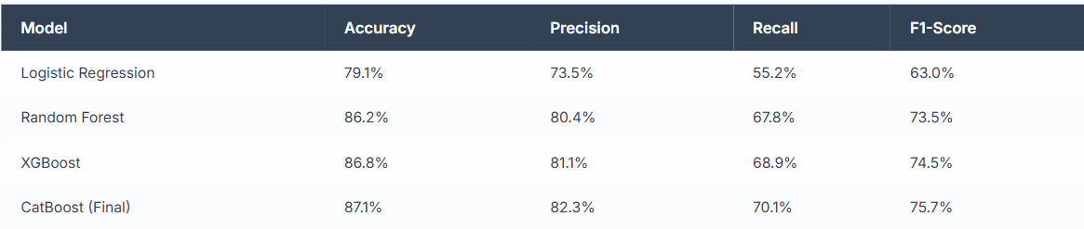
Model Performance Comparison
Classification Results
CatBoost Selection Rationale
CatBoost was selected as the final model due to its superior performance across all metrics. It achieved the highest accuracy of 87.1% and best F1-score of 75.7%, demonstrating excellent balance between precision and recall. The model's native handling of categorical features and minimal preprocessing requirements made it ideal for this churn prediction task.

Slide 9
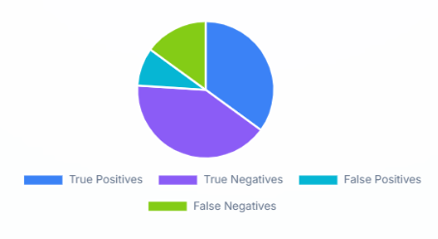
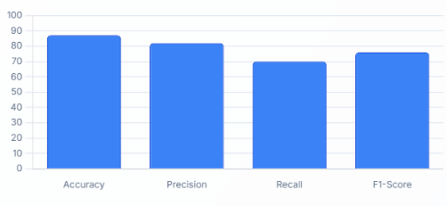
Evaluation Metrics
Model Performance Analysis
Classification Performance
Confusion matrix analysis revealed strong true positive and true negative rates with minimal false classifications, indicating reliable churn detection.
ROC Analysis
ROC curve demonstrated excellent discrimination capability with AUC score of 0.87, showing optimal balance between sensitivity and specificity.

Slide 10
Project Conclusion
Key Achievements and Impact
Technical Success
Developed a CatBoost classifier with 87.1% accuracy
Achieved balanced precision and recall for reliable predictions
Effectively identifies at-risk customers
Key churn indicators: Age, Activity Status, Geography
Business Value
Enables proactive customer retention through early churn risk detection
churn_prediction.csv supports targeted marketing
Provides a scalable, data-driven solution
Helps reduce acquisition costs and protect revenue
Supports real-world applications like alerts and web deployment

